Slide 1
MUSIC RECOMMENDATION SYSTEM
BY TEAM
THE SOOTHSAYER
NAME-DRUVA M HEGDE PES1UG20CS138
NAME-J HIMAKAR PES1UG20CS181

Slide 2

OUTLINE
Why Recommender Systems?
Examples of Recommender Systems
How to build a Recommender System?
Popularity based
Classification based
Collaborative Filtering
A)Nearest Neighbour
B)Matrix Factorization
4. EDA
5.Models used

Slide 3
WHY RECOMMENDER SYSTEM
Music dataset is too big while life is short!!!! You need someone to teach you how to manage and give you wise suggestions according to your taste!
With the rise of digital content distribution, people now have access to music collections on an unprecedented scale. Commercial music libraries easily exceed 15 million songs, which vastly exceeds the listening capability of any single person. With millions of songs to choose from, people sometimes feel overwhelmed. Thus, an efficient music recommender system is necessary in the interest of both music service providers and customers. Users will have no more pain to make decisions on what to listen while music companies can maintain their user group and attract new users by improving users’ satisfaction.

Slide 4
HOW IT WORKS
WORK FLOW
MUSIC
RECOMMENDATION MODEL
PREDICT THE USER
SONG
USES STORED
USER DATA

Slide 5
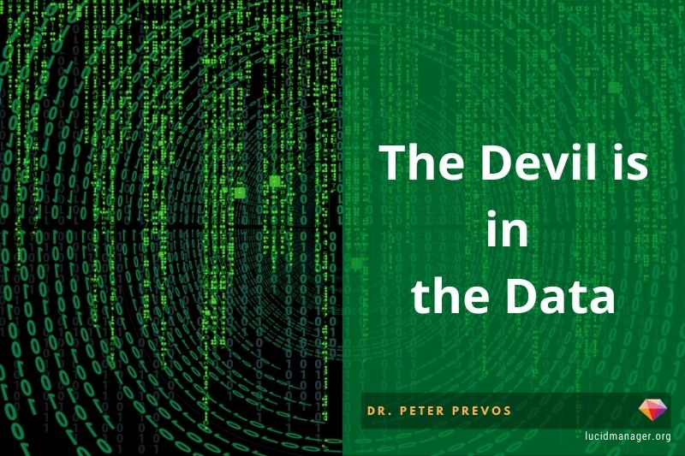
DATASET
A)Features C)problems faced
Large-scale: No user info pertaining to his like/dislike
1 000 000 users 10,000songs No info pertaining to the genre
Too big dataset: Difficult to implement the whole dataset,
so need to create a small dataset
B)content ourselves 1)Triplets (user, song, count)
2)Meta-data pertaining to the music
Containing the album, artist release date,
Listen count

Slide 6
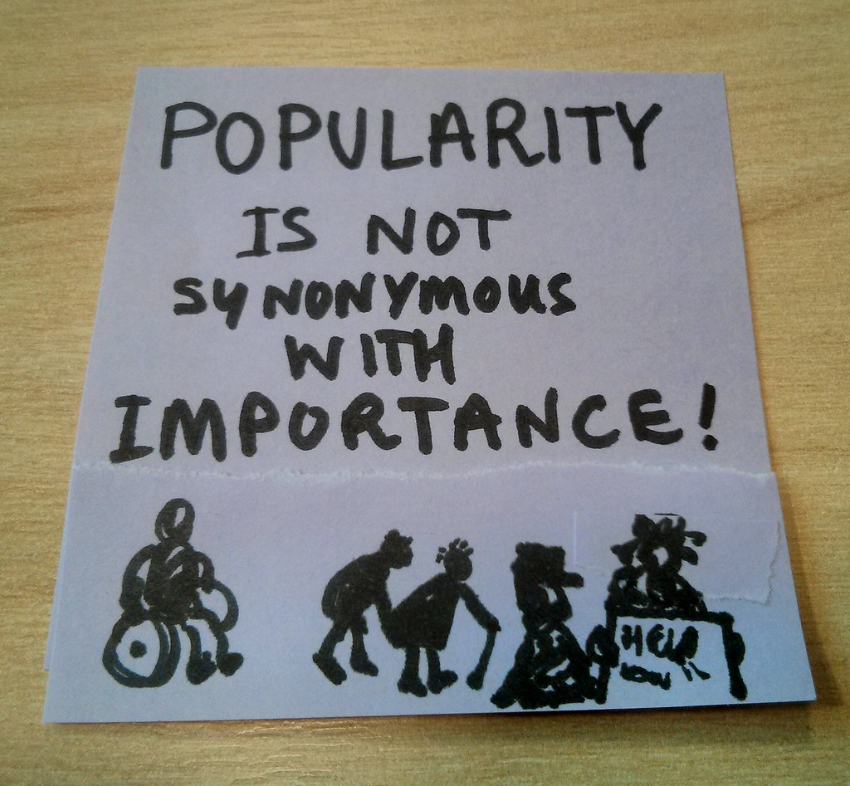
Popularity based
Idea
1. Sort songs by popularity in a decreasing order
2. For each user, recommend the songs in order of popularity, except those already in the user’s profile
Pros:
Idea is simple
Easy to implement
Served as baseline
Helps to recommend when we have no information about the user
Cons:
Not personalized (users and songs’ information is not taken into account)
Biased towards popular song

Slide 7
COLLABORATIVE FILTERING
USER BASED
Idea:
Find users who have a similar taste of products as the current user. Similarity is based upon similarity in users’ Listening behaviour
ITEM BASED
idea
To define similarity among a set of items, we need a feature set on the basis of which both items can be described.
In our case it will mean features of the songs on the basis of which one song can be differentiated from another
Since our dataset don't have this data, we can use the Jaccard index to do an implicit similarity,
based on common users, in terms of the users who listen to these songs.
The Jaccard coefficient measures similarity between finite sample sets, and is defined as the size of the intersection divided by the size of the union of the sample sets
The basic idea remains that if two songs are being listened to by a large fraction of common users out of the total listeners, the two songs can be said to be similar to each other

Slide 8
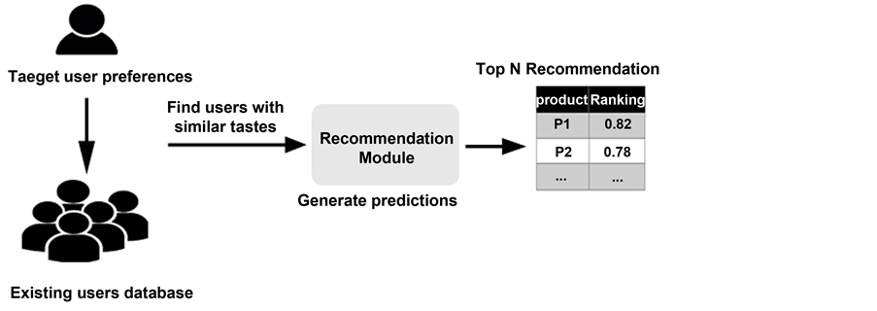
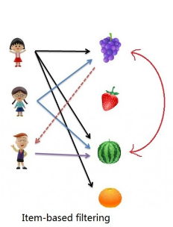
User based
Item based filtering

Slide 9
LATENT FACTOR MODEL(Matrix factorization)
They are probably the most used recommendation engines when it comes to implementing recommendation engines in production.
Matrix factorization are methods that reduce a matrix into constituent parts, such that when these matrices are multiplied we get the original matrix. It make it easier to calculate more complex matrix operations. Matrix factorization methods, also called matrix decompositions methods, are a foundation of linear algebra in computers, even for basic operations such as solving systems of linear equations, calculating the inverse, and calculating the determinant of a matrix.
Matrix factorization can be used to discover latent features between two different kinds of entities. For example, we can try to explain a song in mathematical terms by measuring its beats, tempo, and other such features and then define similar features in terms of the user. Once we have consciously defined such "features", we can use them to find matches for a user based on some similarity criteria. You can use matrix factorization to discover these latent features and they seem to work great

Slide 10
The starting point of any matrix factorization-based method is the utility matrix, a matrix of user Vs item dimension. Not, this is a sparse matrix, since not all item is used by the user. The process of matrix factorization means finding out a low rank approximation of the utility matrix. So we want to break down the utility matrix U into two low rank matrices so that we can recreate the matrix U by multiplying those two matrices:
Assuming the process helps us identify latent factors/features, meaning as K, our aim is to find two matrices X and Y such that their product (matrix multiplication) approximates R.
X = |U| x K matrix (A matrix with dimensions of num_users * factors)
Y = |P| x K matrix (A matrix with dimensions of factors * num_songs)
PROS
LESS STORAGE
FASTER COMPUTATION

Slide 11
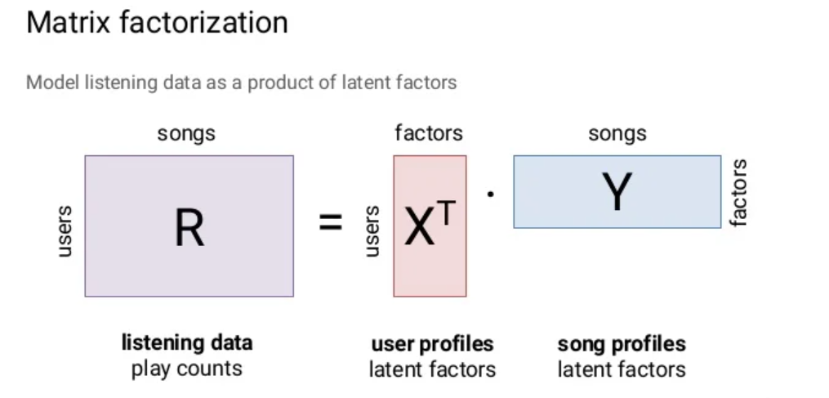

Slide 12
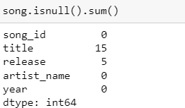
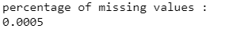
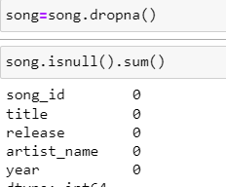
EDA
Preprocessing
Had to drop some missing values from the dataset

Slide 13
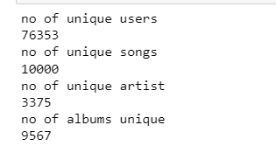
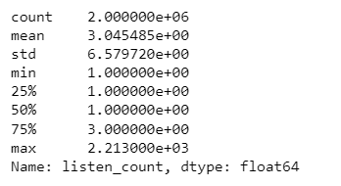
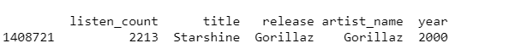
Total number of unique
Songs-10,000
Users-76,353
Most users listen to a song exactly ones and only top 25 percent listen to
A song thrice the max listen count for the song is 2213 for starshine by gorillaz

Slide 14
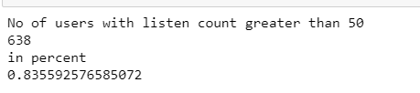
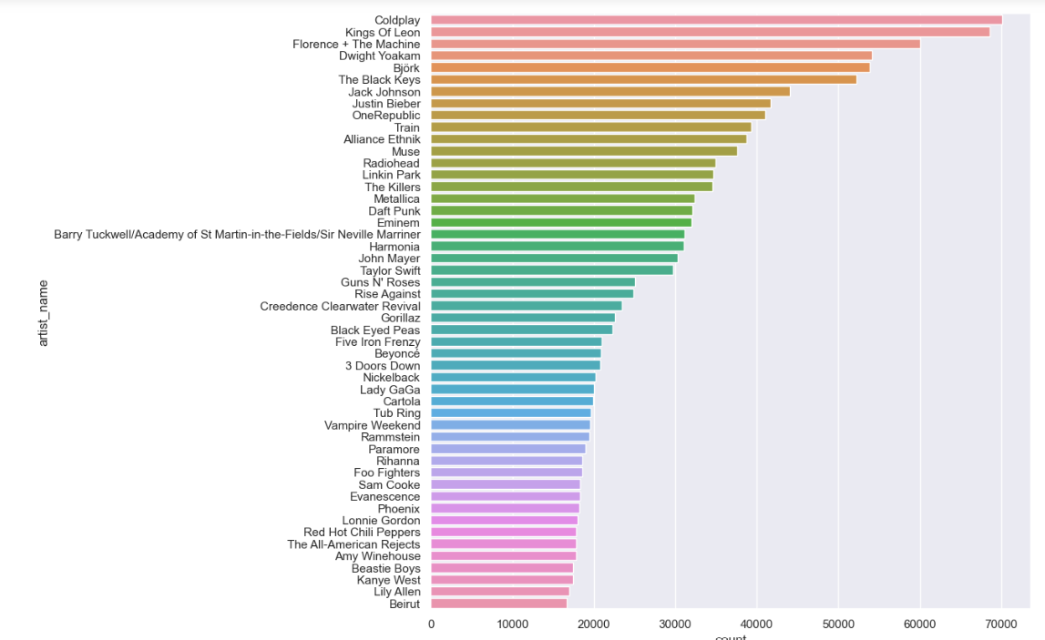

Popular artist

Slide 15
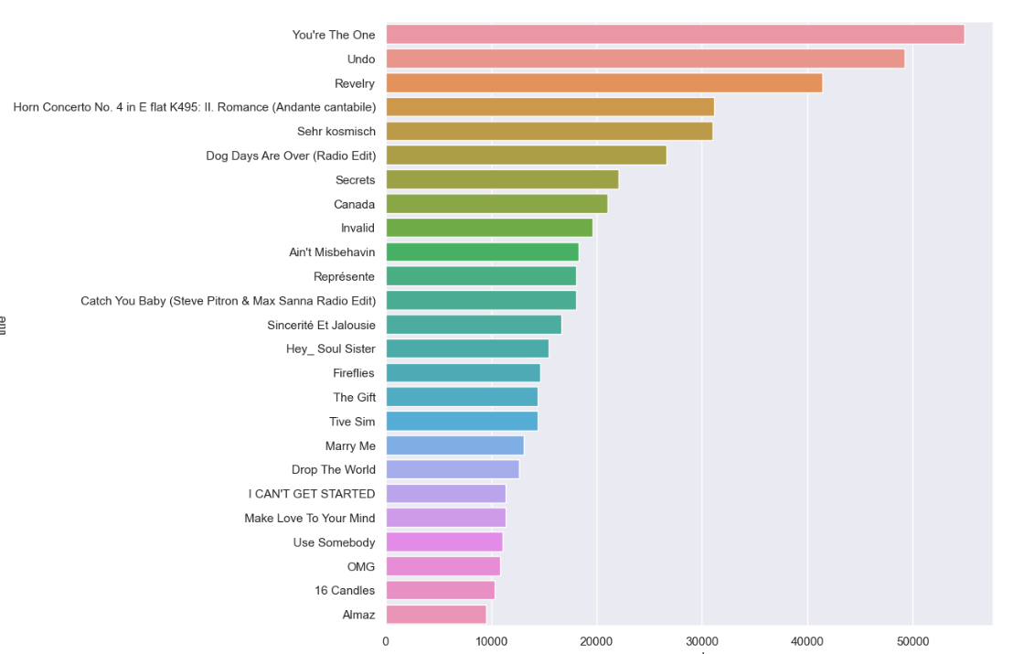
Popular songs

Slide 16
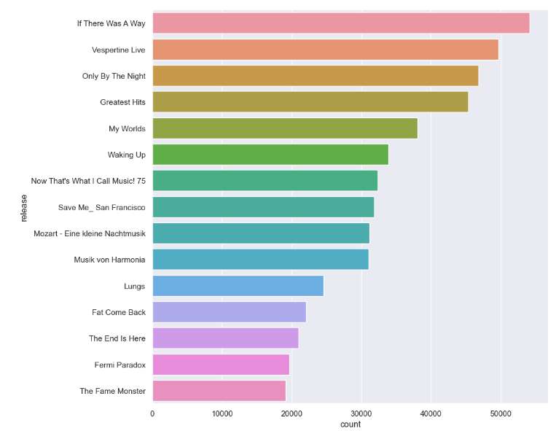
Popular albums

Slide 17
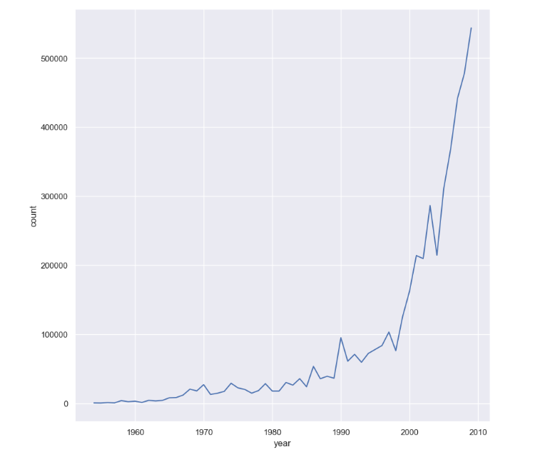
Music growth trend

Slide 18

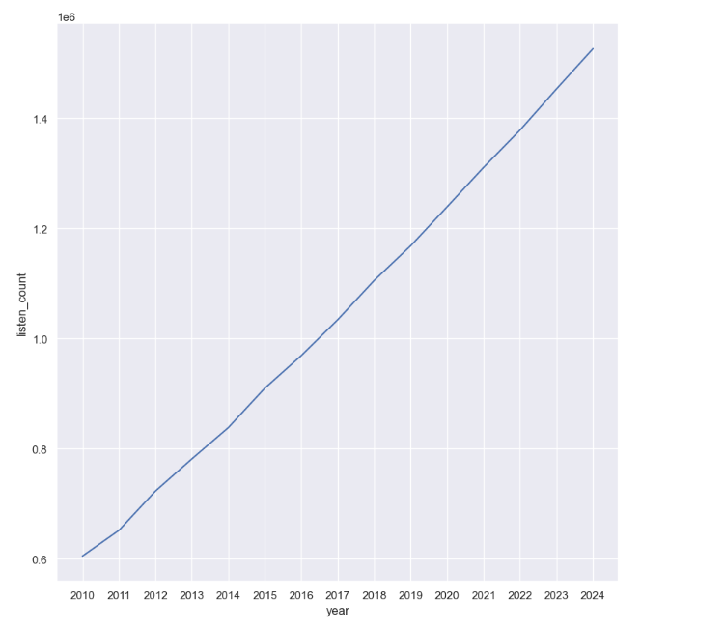
Expected listen count in coming years

Slide 19
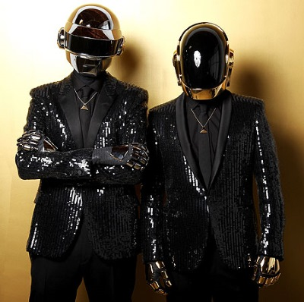
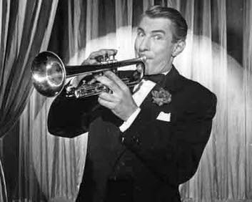
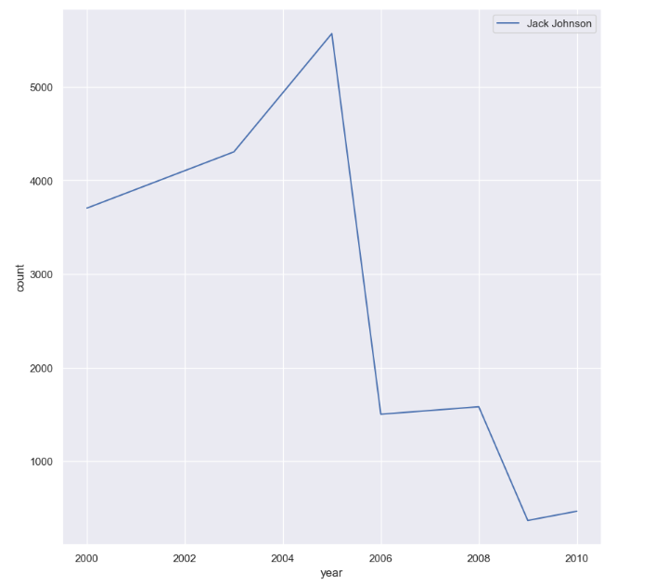
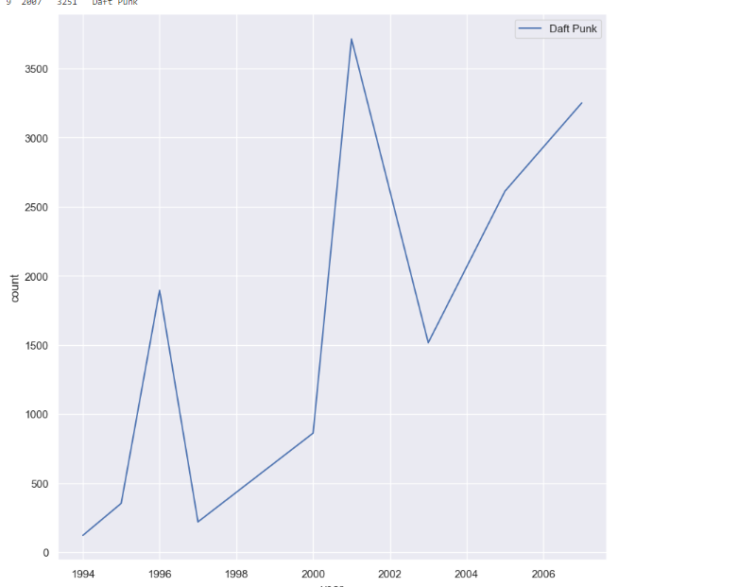
Popularity graph of some artist over the years

Slide 20
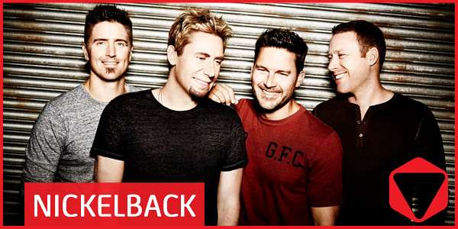
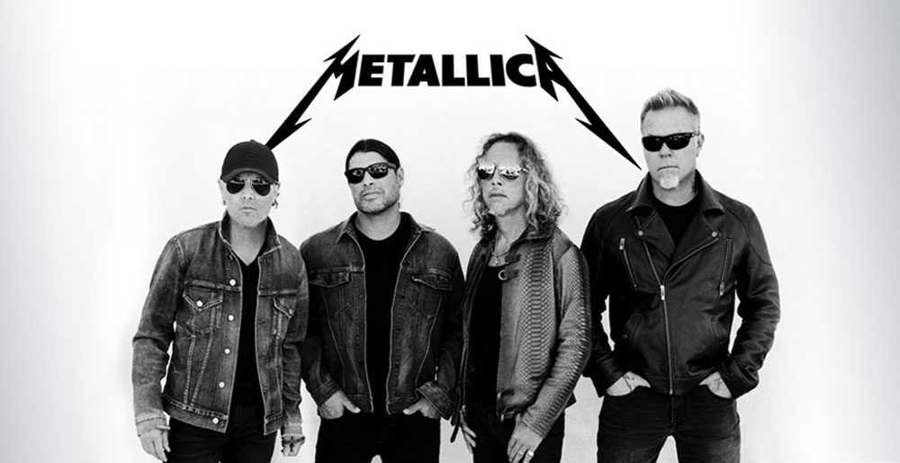
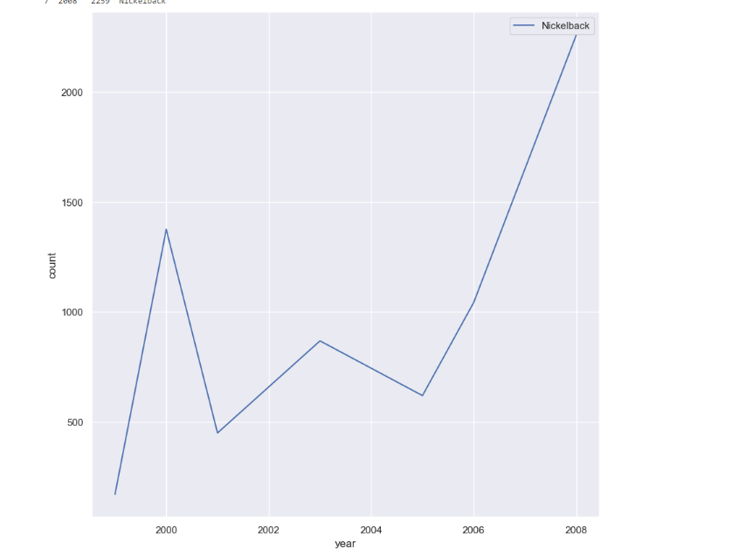
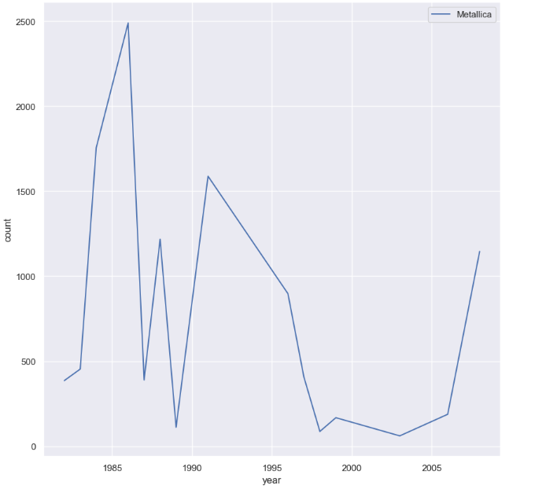

Slide 21
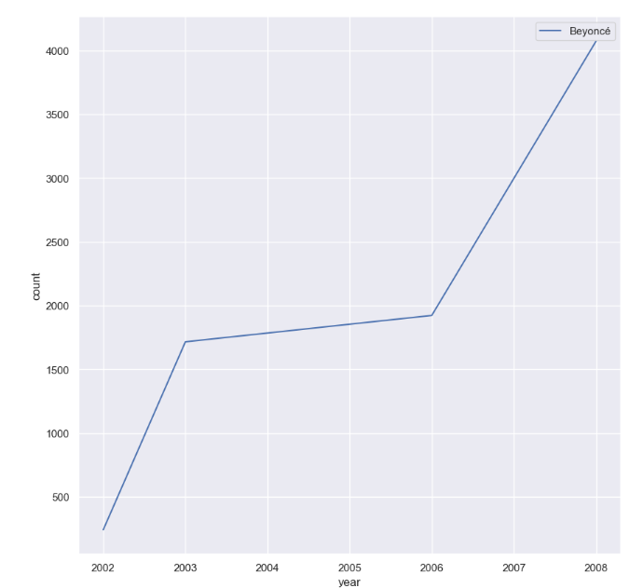
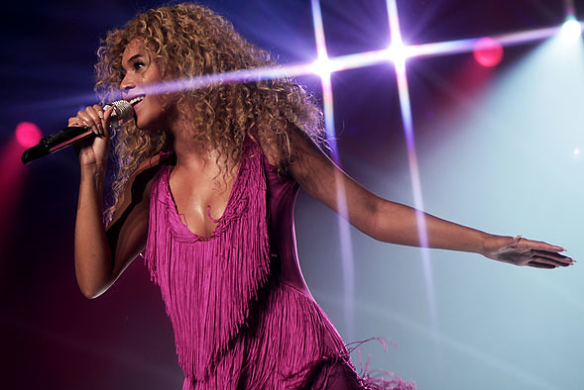

Slide 22
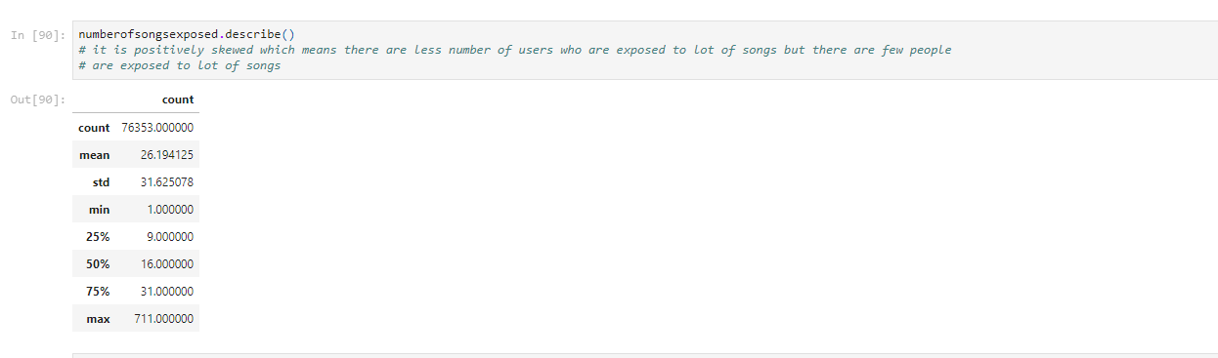

Slide 23
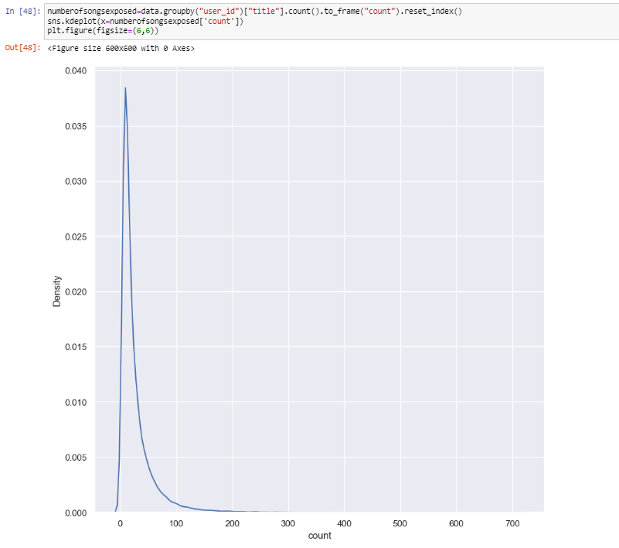
Number of songs a user is exposed to

Slide 24
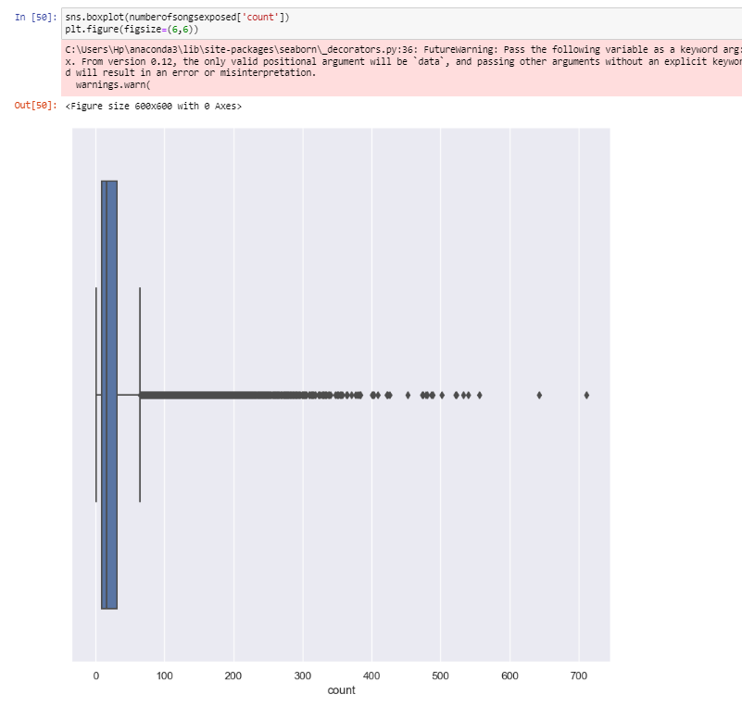
Boxplot of
Number of exposed songs
Shows ouliers

Slide 25
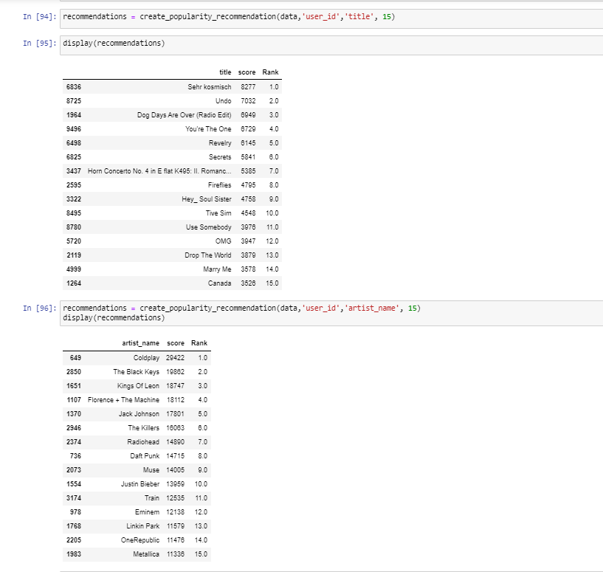
Popularity based recommendation

Slide 26

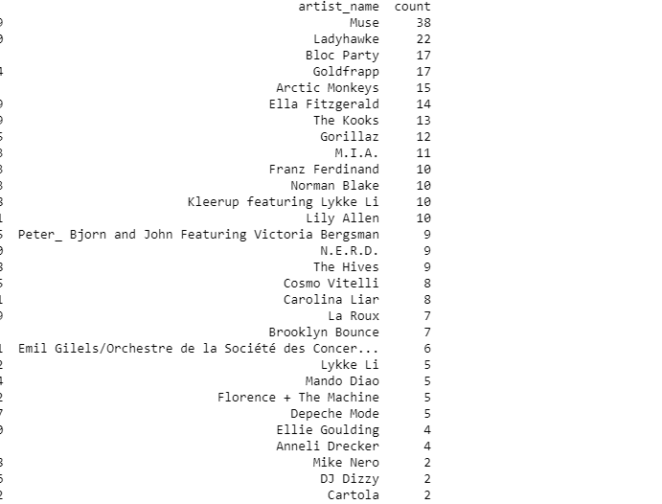
Item based collaborative
Using Jaccard’s index

Slide 27
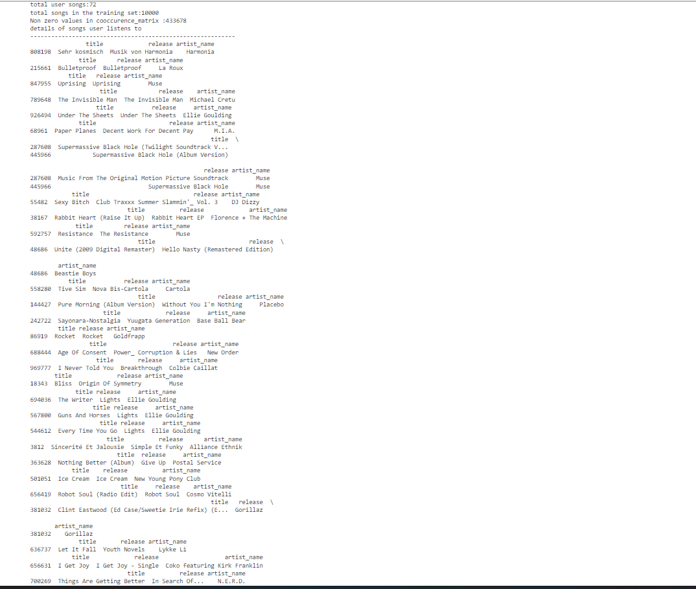

Slide 28
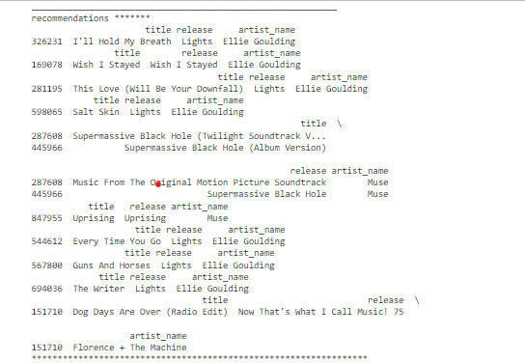

Slide 29
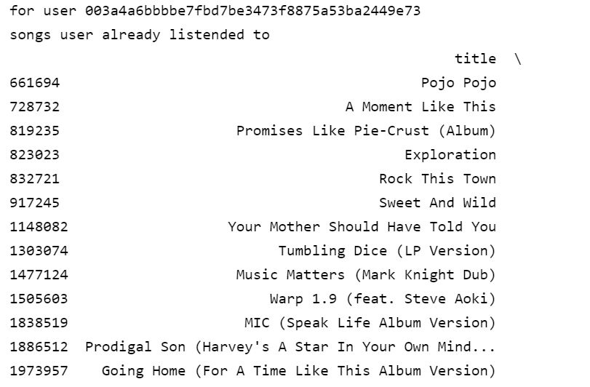
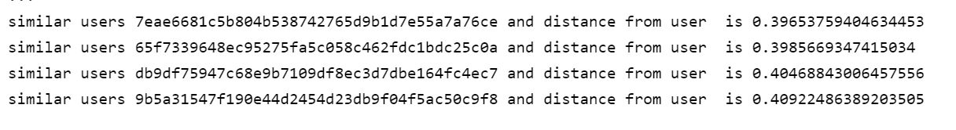
User based
KNN BASED

Slide 30
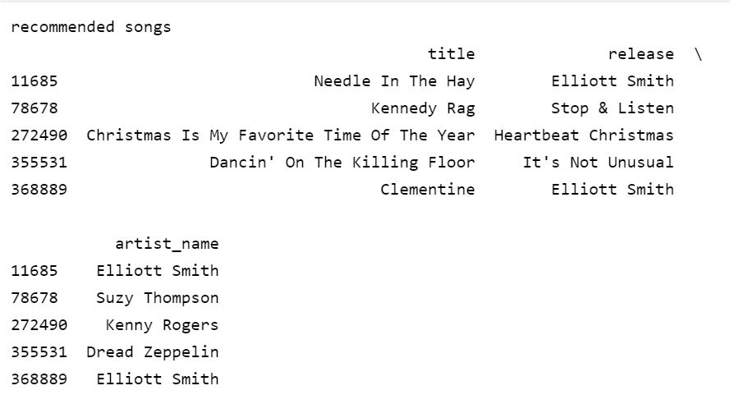

Slide 31
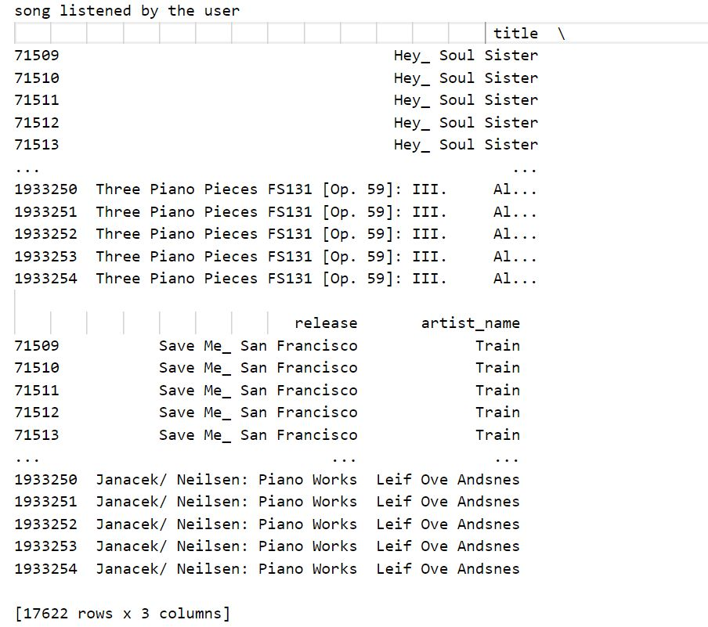
PEARSONS COEFFICIENT

Slide 32
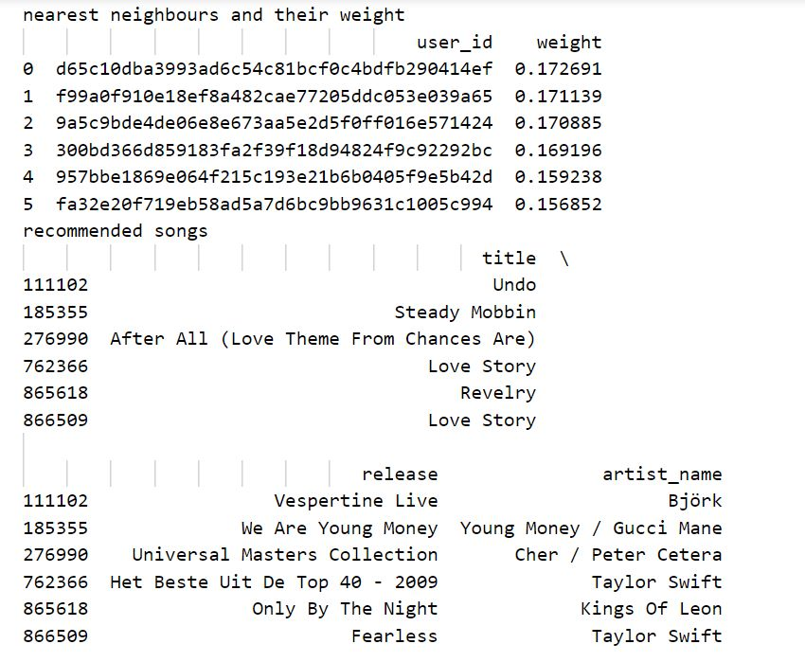

Slide 33
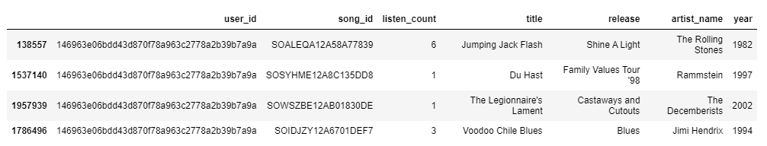
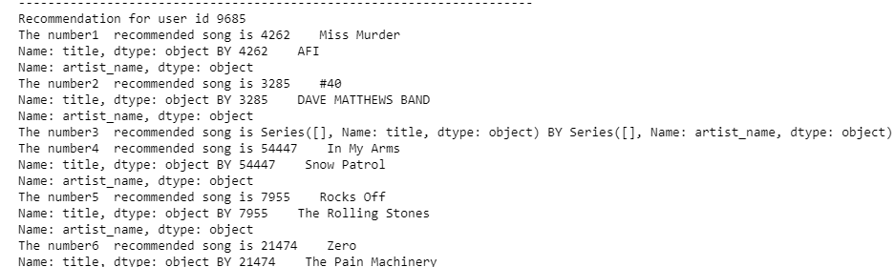
SVD
Songs the user listened to

Slide 34
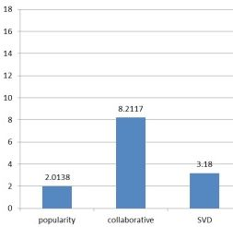
EVALUATION METRICS
PRECISION

Slide 35
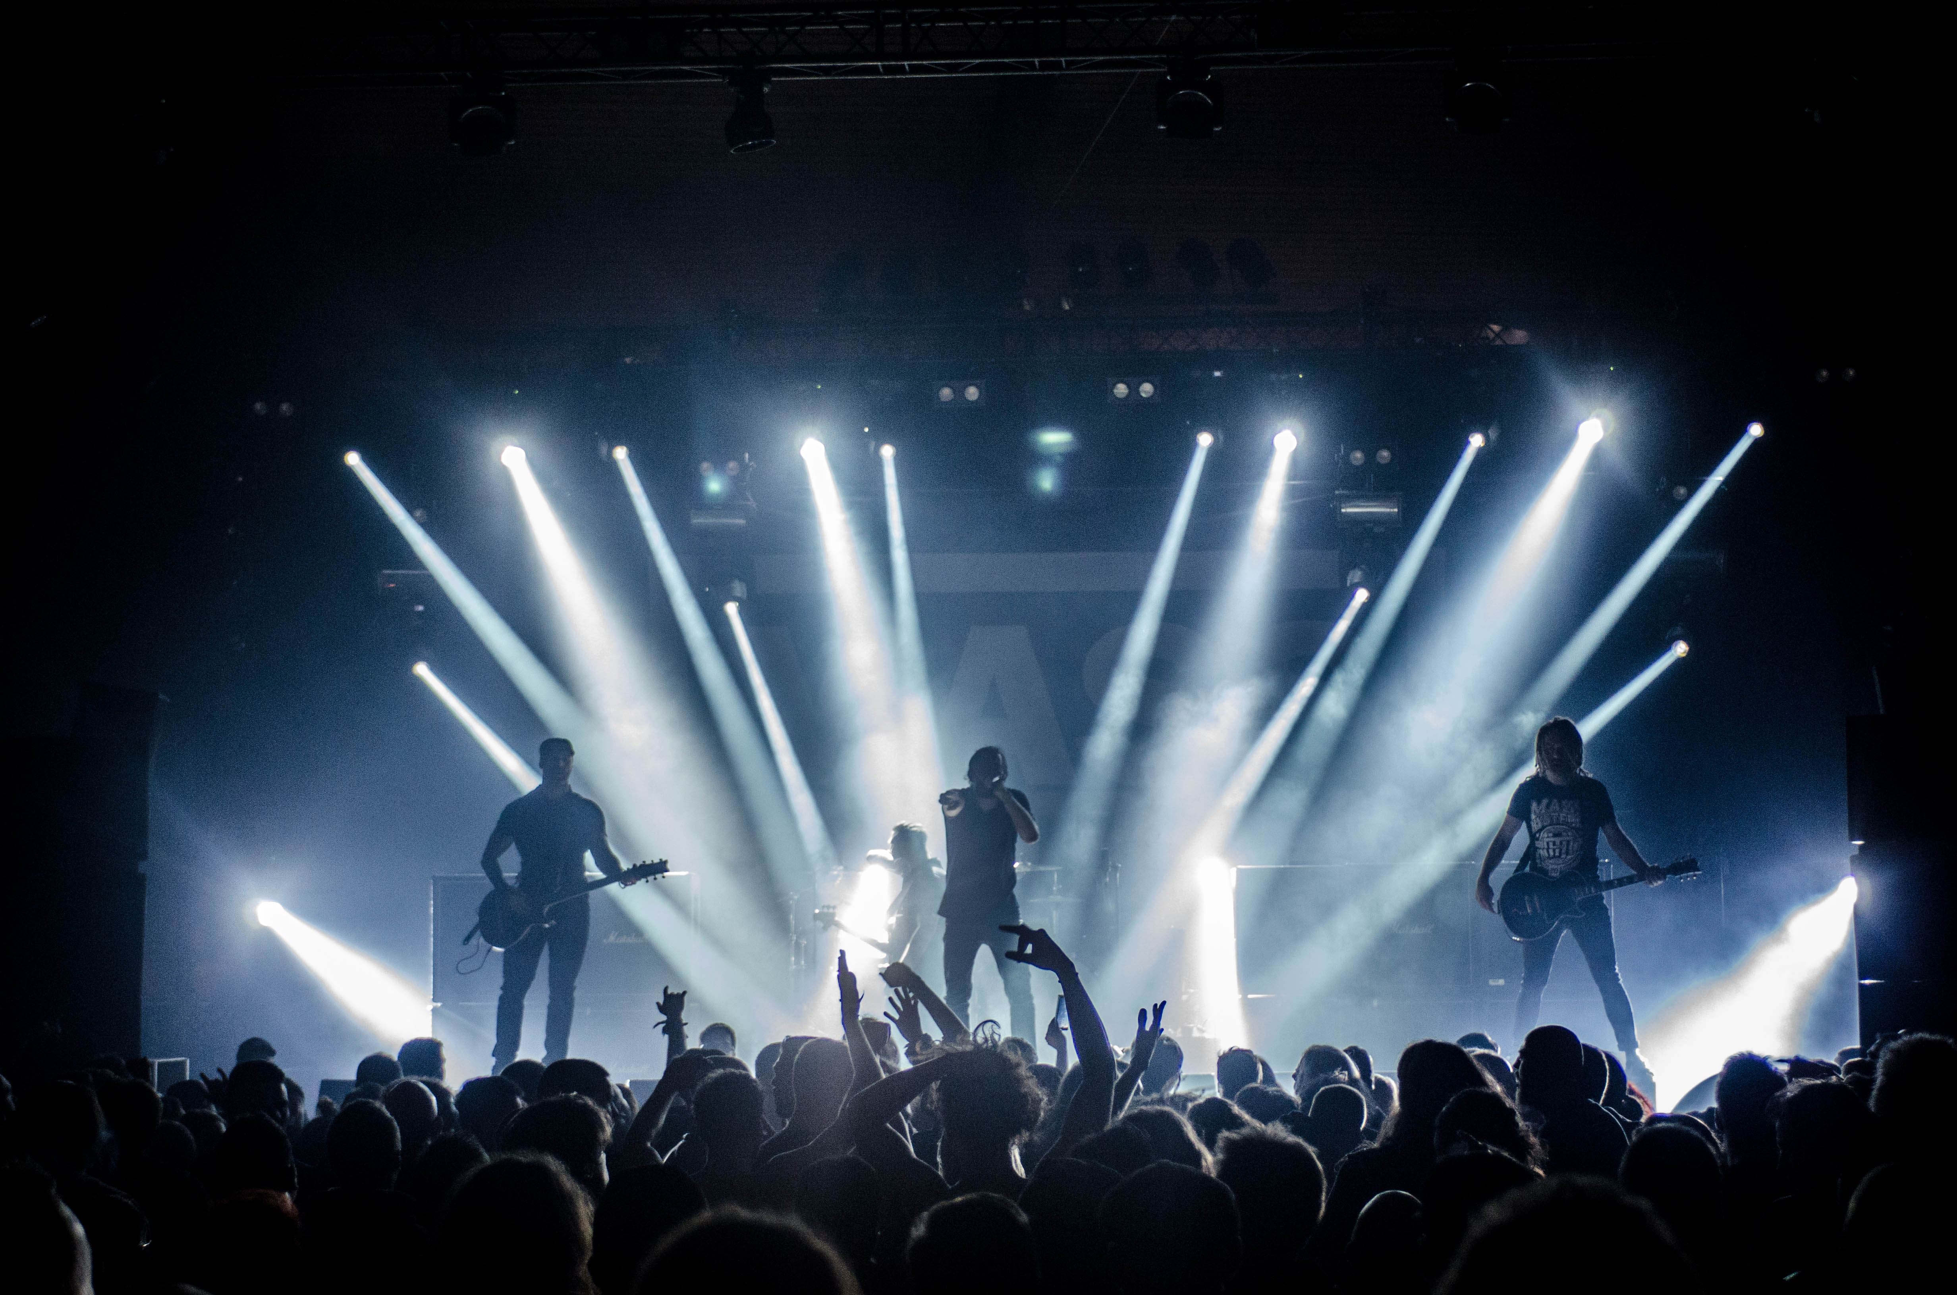
THANKING YOU
TEAM
THE SOOTHSAYER

